Slide 1
Indian Health Service
Simple Mesage Mover

Slide 2
Simple Message Mover
Transfers HL7 immunization messages to the state/local Immunization Information System (IIS).
Independent application and resides out completely outside of RPMS.
Open source application
Expert system capable of connecting with multiple state/local out-of-the-box.
Will support MU 2 requirements.

Slide 3
HL7 Bridge
Java based application.
Currently supported limited number of IIS.
HL7 Bridge does not support latest CDC standard.
HL7 Bridge can not be changed to meet current CDC guidelines and MU requirements.
SMM will fully replace HL7 Bridge functionality.

Slide 4
SMM Transport Standards
HTTPS Post
  Old IIS transport standard, still used by many IIS.
SOAP Web Services
  New standard is called TLEP. SMM will support this.
  Many IIS have created variations similar to TLEP standard.
PHIN-MS
  Could support in the future
sFTP, FTPS, etc.
  Not currently planning to support as not real-time.

Slide 5
SMM compared to HL7 Bridge
Will resend messages that can not be sent to the IIS because of connectivity issues.
Will be easier to configure.
Will better support real-time queries and updates.
Will support remote monitoring.

Slide 6
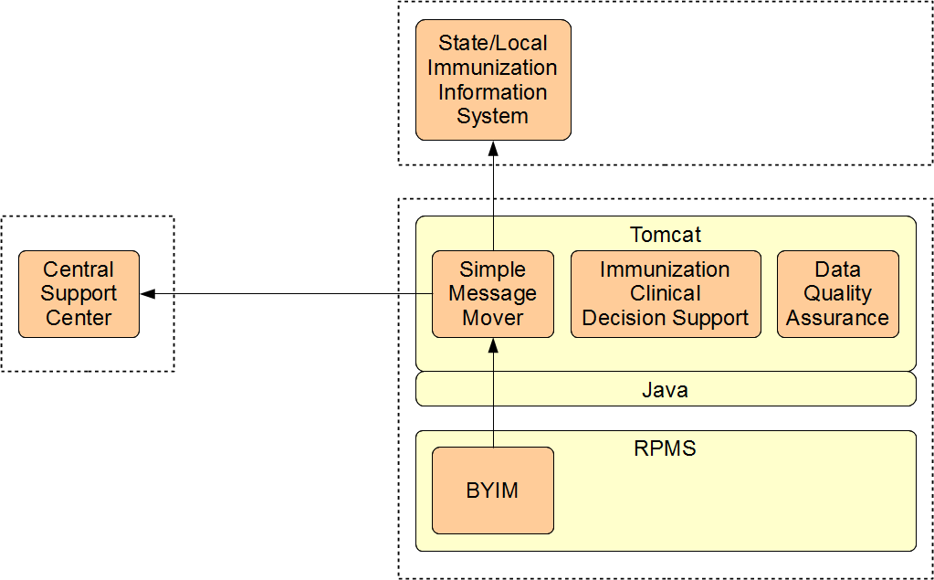
System Architecture

Slide 7
Development Status
Alpha version was released and installed in Tucson October 2012.
Beta version was release November 2012.
Release 1.08 is being tested by IHS security

Slide 8
How it Works

Slide 9
Folder Layout
(Tomcat application home)
  /webapps – Web applications are stored here
    /smm – SMM application
(SMM Root Folder)
  /transfer – Where data is saved
    /backup – Copy of what is being or has been sent
    /request – What needs to be sent or is being sent
    /response – What was returned
    /sent - What was actually sent (similar to backup)
    /update – VXU’s from the state (Reciprocal)

Slide 10
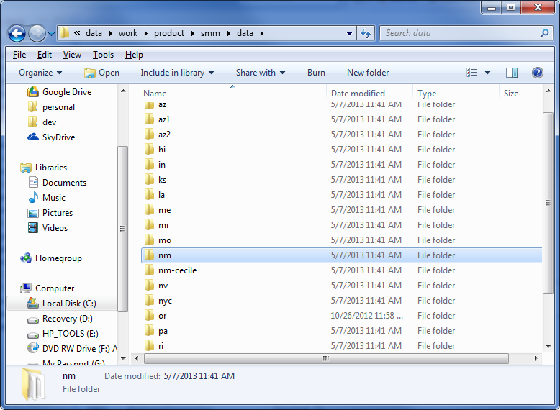
SMM Root Folder Example

Slide 11
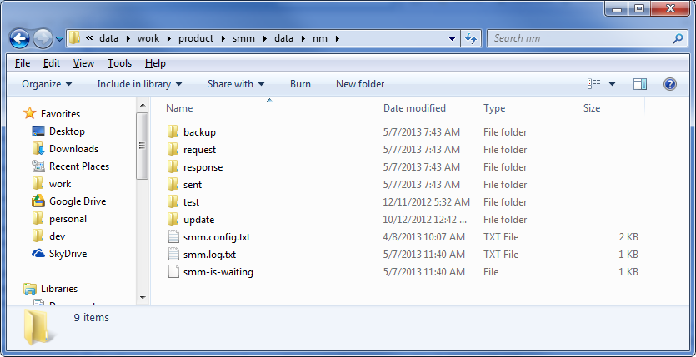
Transfer Folder

Slide 12
Folder Scanning
SMM Root Folder is recursively-scanned once when SMM first starts
Folders that have an smm.config.txt are added to the list of SMM transfer directories
  New folders are ignored one SMM has finished scanning, restart Tomcat to recognize new folders
Every 5 seconds the smm.config.txt is read and the SMM looks for data to send
  Changes to the configuration are automatically recognized the next time SMM sends

Slide 13
SMM Configuration File
Named smm.config.txt
Created during installation process
Includes URL and credentials to connect
Password is obscured in file but not secure

Slide 14
SMM Log File
Written by the SMM during its last processing run
Connection problems are noted here
Errors or rejections by the IIS are not

Slide 15
SMM Status file
smm-is-waiting: running normally but has no data to send.
smm-is-starting: configuring folders and connection settings.
smm-is-looking: looking in the folder to see if there is data to send.
smm-is-preparing: reading the data to be sent and preparing it to be sent.
smm-is-sending: actively connecting to the IIS and submitting data.
smm-has-problem: unable to connect with external because of an unexpected problem during transmission.

Slide 16
Transmission Issues
Can be caused by:
  Internet down
  IIS down
  IIS returns exception or out-of-service message
Not caused by:
  Data or message format problems
SMM will wait and then try again:
  30 sec, 1 min, 2 min, 4 min, 8 min, 16 min, 30 min, 1 hour, 2 hours, 4 hours, 8 hours, 12 hours, 1 day

Slide 17
Request Folder
Only for HL7 files to be sent
Can be single messages or batches of messages
When sending

Slide 18
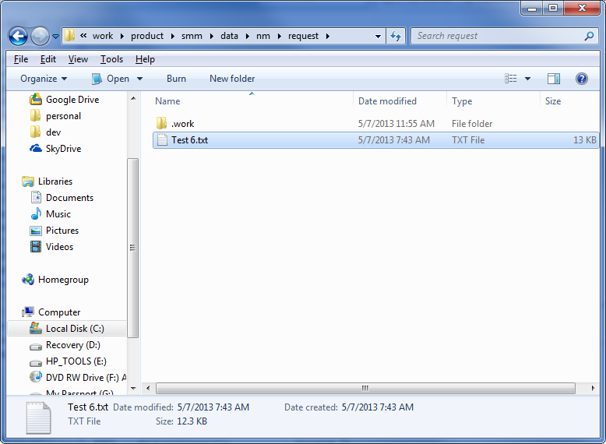
Processing a File

Slide 19
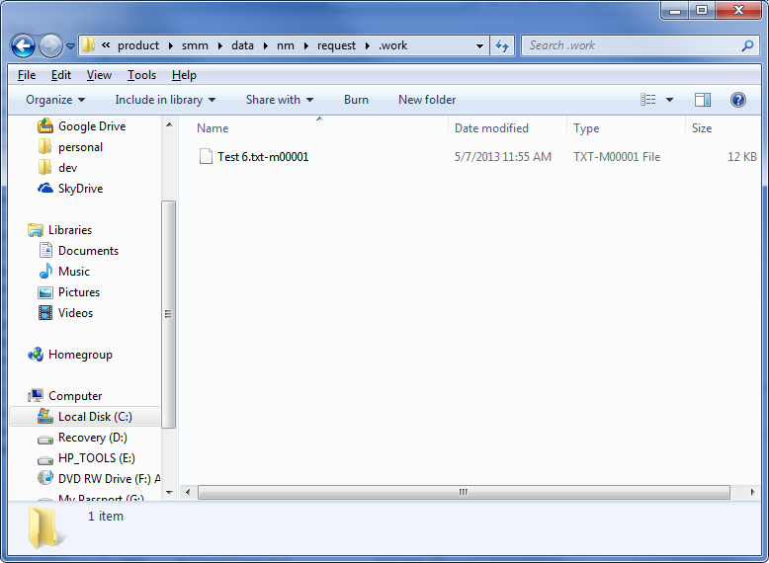
Processing a File

Slide 20
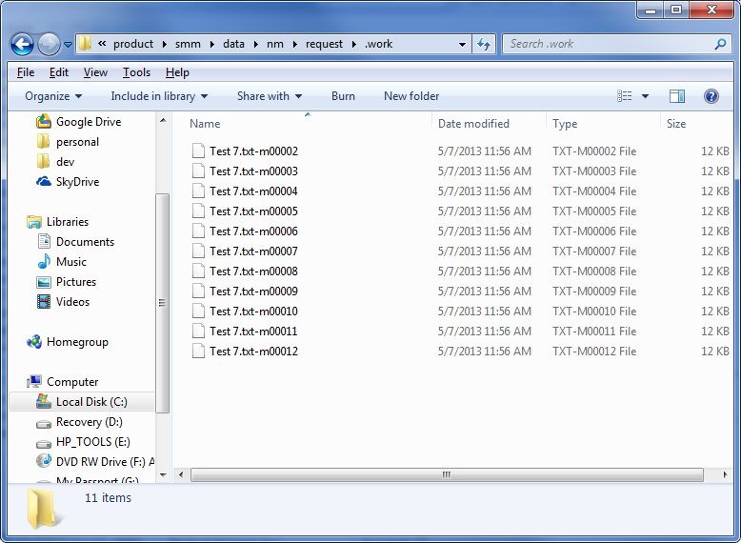
Processing a Batch File

Slide 21
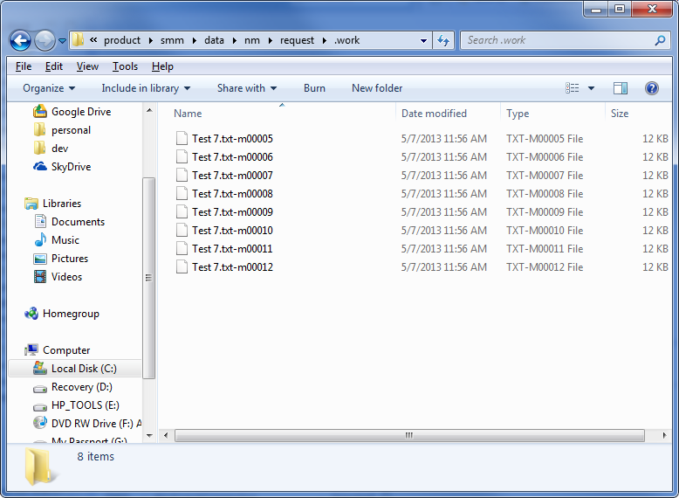
Processing a Batch File

Slide 22
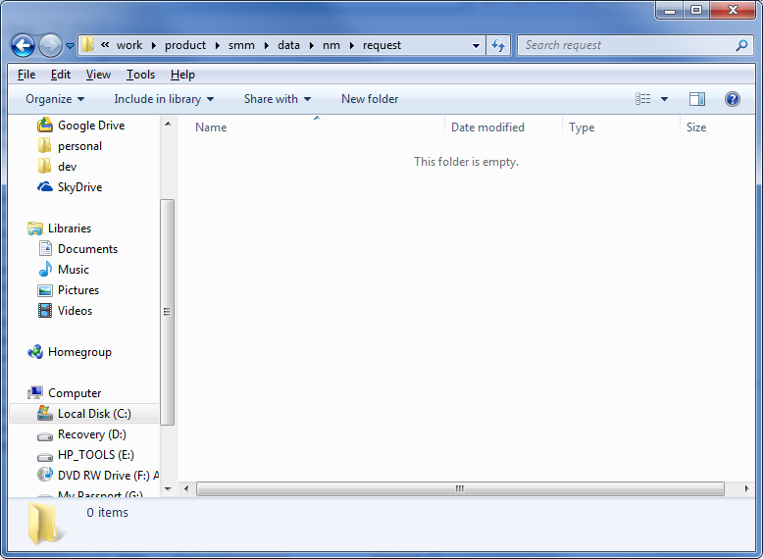
Finished Processing

Slide 23
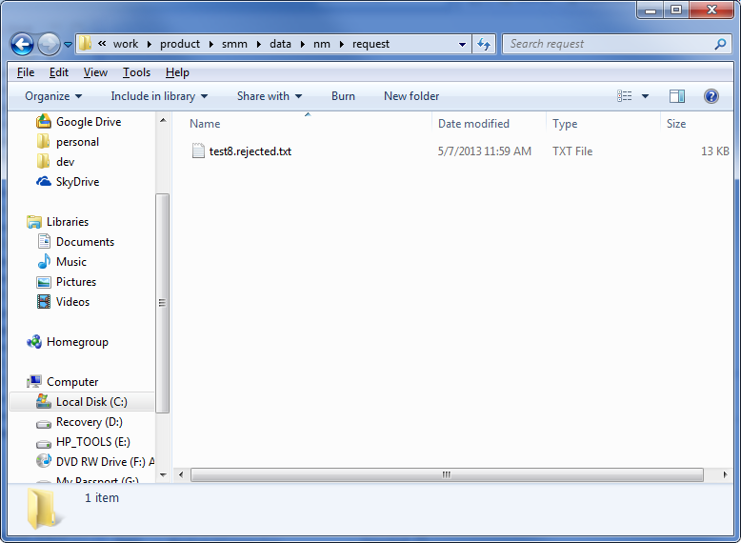
Rejected Message

Slide 24
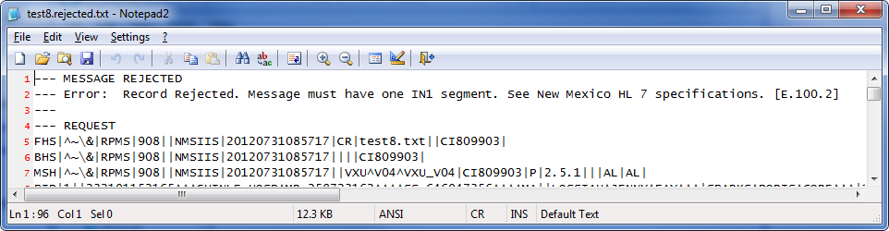
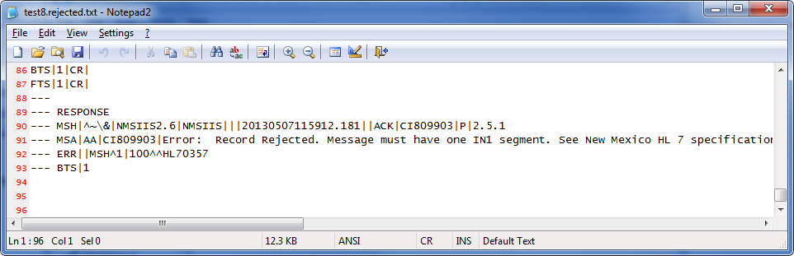
Rejected Message

Slide 25
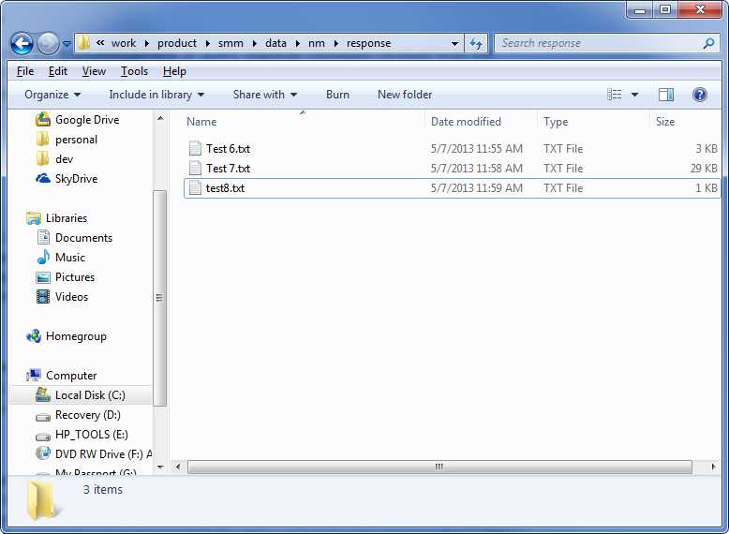
Response Folder

Slide 26
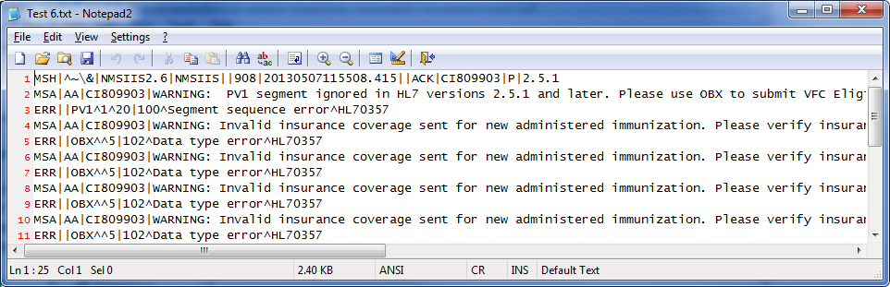
Response File Example

Slide 27
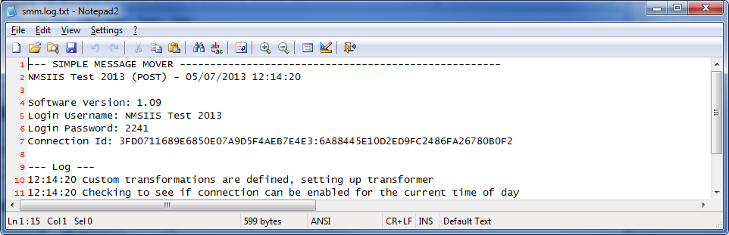
Centralized Logging
Must be enabled
Submission status of messages logged here: http://ois-dqa.net/dqa/remote
Login using parameters from smm.log.txt file.

Slide 28
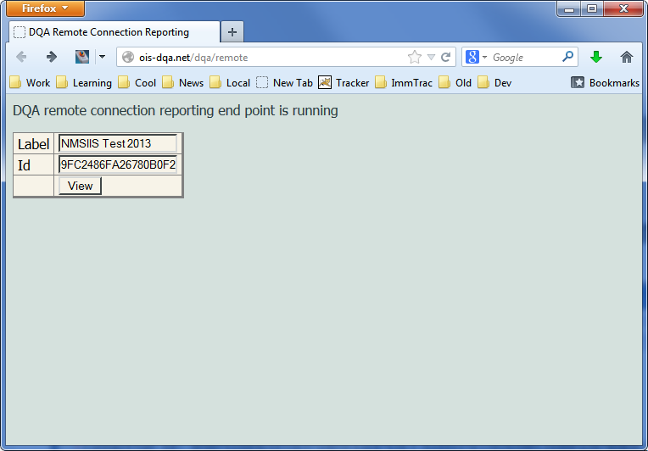
Logging In

Slide 29
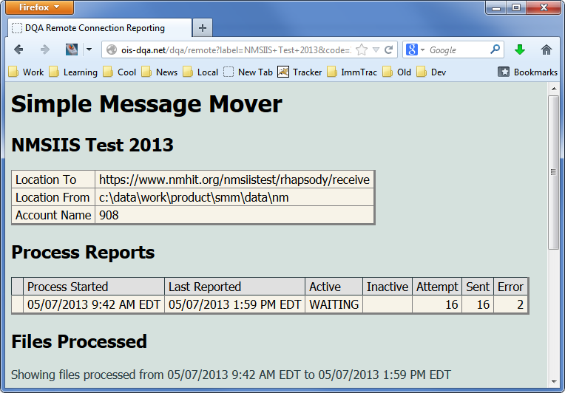
Logged Information

Slide 30
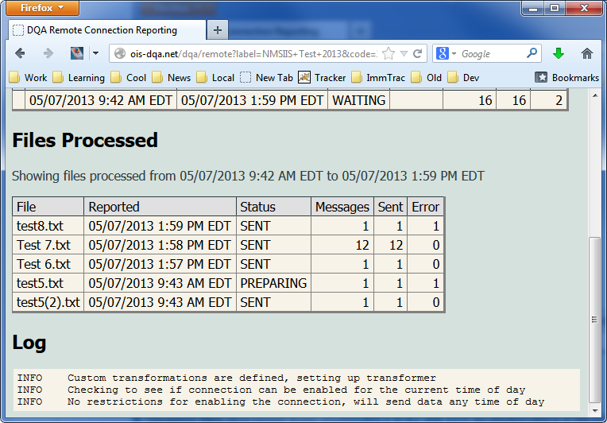
Logged Information

Slide 31
Installation Process
Navigate to the SMM documentation:
https://openimmunizationsoftware.net/interfacing/smm/simpleMessageMover.html
Select Installation
Read instructions
Follows steps 1 - 4

Slide 32
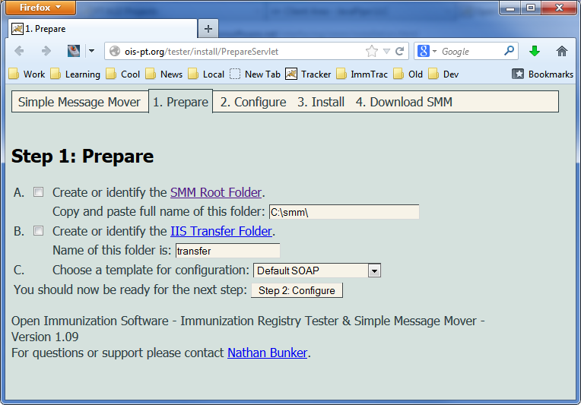
Step 1: Prepare

Slide 33
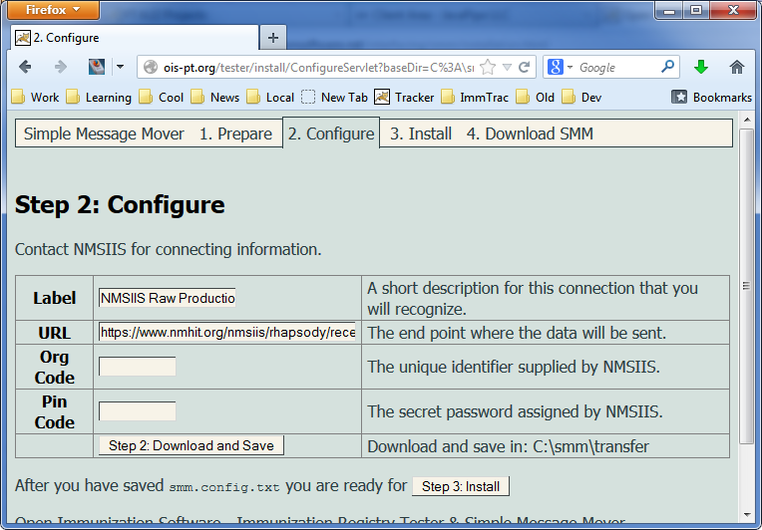
Step 2: Configure

Slide 34
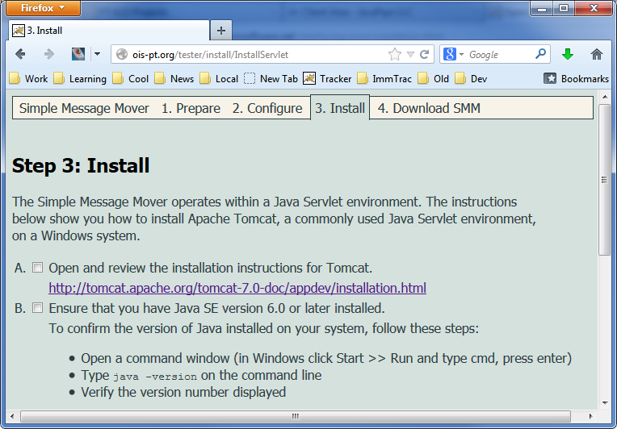
Step 3: Install Tomcat

Slide 35
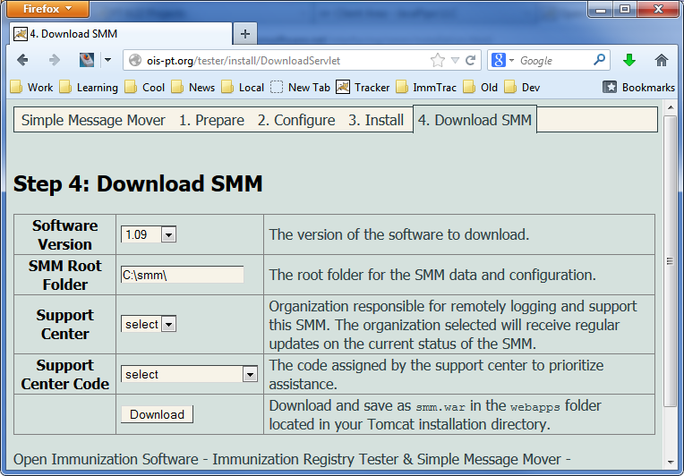
Step 5: Download SMM

